Slide 1
Using Administrative Data in Analyzing Program Outcomes
NAWRS 2013
Chicago, IL
August 20, 2013
Don Winstead
Don Winstead Consulting, LLC

Slide 2
Three Key Points
Connect every level of the organization to drive performance.
Make outcome data accessible.
Use longitudinal data to go from “snapshots” to “movies”.

Slide 3

 | Florida Department of Children and Families Quality Management System
Notes:
Completing the Review:
The next section of the review sheet is the Review Elements. It includes all elements associated with the review type. The “Tier I correct?” column lists the designated reviewer findings for each element. The Codes column contains links to all error codes associated with each element. Note that critical elements, in this example element number 18, payment/eligibility is in red font.

Slide 4
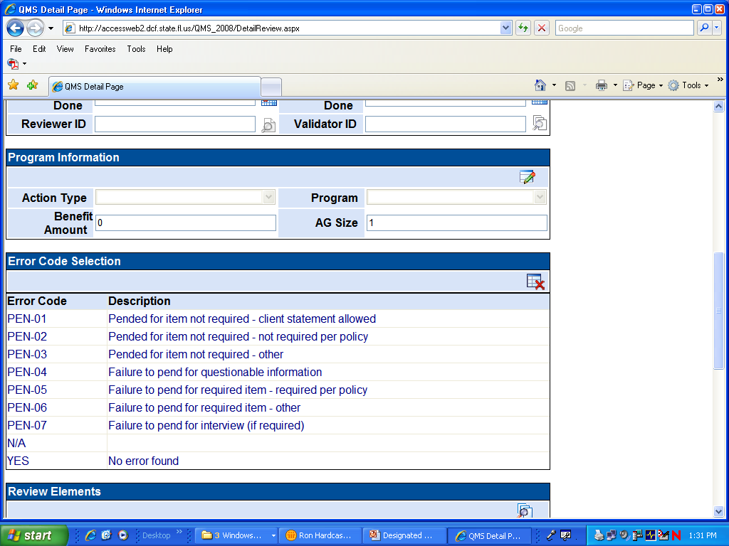
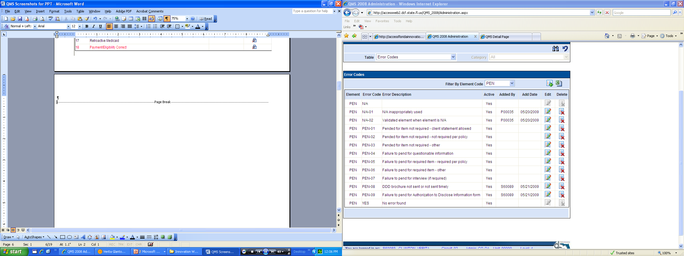
Completing the Review
Notes:
With the release of QMS version 3.1 element fields no longer default to “Yes”. The Designated Reviewer must select Yes, the appropriate error code or N/A for each element.
 Click on the Codes icon to the right of the element being coded to score the element. The system will display a pane listing all coding options for the element. If there is not an error associated with the element, click on the Yes coding option. The system will retain the Yes in the element Correct field. If there is an error associated with the element, click on the appropriate error code. Elements that do not apply to the program being reviewed should be coded N/A. For example, you should code the Continuous Medicaid and Retroactive Medicaid elements N/A when completing a Food Assistance Program review.
At times an element may apply to the program being reviewed, yet not apply to the specific assistance group being reviewed. For example, although Continuous Medicaid applies to the Medicaid program, if the review involves a newly entitled Medicaid assistance group, where continuous Medicaid does not apply, the element should be coded N/A.
There are also circumstances where the element applies to the program and the assistance group being reviewed, even though there is no budgeted expense. For example, when an eligibility specialist correctly determines that a Food Assistance assistance group does not incur any shelter or utility expenses, these elements should be coded Yes as correct. In this case a decision point was required for each of these elements; the specialist had to determine if the assistance group incurred shelter or utility expenses.
When more than one error exists for an element, payment/eligibility errors should be coded first. When no payment/eligibility errors exist, code the error with the most potential to impact the assistance group’s eligibility or benefit level. Reference all errors, including errors that are not coded with the review element, in the comments section, as all errors need to be corrected.

Slide 5
 | Florida Department of Children and Families Quality Management System
Ongoing Case Reviews Completed July 1, 2012 through June 30, 2013
 | 1st Level Review Designated Reviewer (Local) | 2nd Level Review Validator (Headquarters)
TANF | 194 | 3
SNAP | 15,917 | 920
Medicaid | 26,350 | 1,571
Total | 42,461 | 2,494

Slide 6
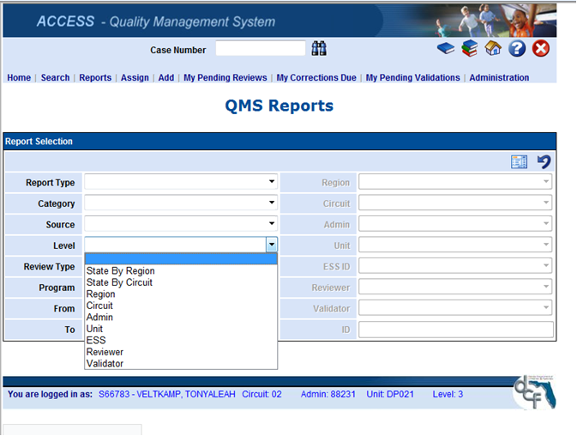

Slide 7

Food Stamp Payment Accuracy
Florida's 2012 error rate 0.77% - National 3.42%
FFY 2012
FFY 2011
FFY 2010
FFY 2009
FFY 2008
FFY 2007
Best in Country
#1
2nd Best in Country
Best in Country
Best in Country
Best in Country
Most Improved
Over $47 million in federal bonus funds in the past six years.

Slide 8
Making Outcome Data Accessible
Two Examples
Scorecards
Spinner Charts

Slide 9
Application Processing – June 2013
Region | Circuit | All Program Approvals | Expedited SNAP Approvals | Regular SNAP Approvals | All SNAP Approvals | Cash Approvals | Regular Medicaid Approvals | Disability Medicaid Approvals
NW | 1 | 97.2% | 97.6% | 95.8% | 96.5% | 100.0% | 97.7% | 98.9%
NW | 2 | 97.0% | 95.5% | 96.0% | 95.8% | 97.0% | 99.2% | 99.4%
NW | 14 | 97.7% | 96.8% | 96.5% | 96.6% | 100.0% | 98.5% | 100.0%
NW | Subtotal | 97.3% | 96.8% | 96.0% | 96.4% | 99.4% | 98.3% | 99.4%
NE | 3 | 96.1% | 82.8% | 96.2% | 92.6% | 100.0% | 95.6% | 99.6%
NE | 4 | 97.4% | 96.7% | 96.6% | 96.6% | 96.7% | 98.4% | 98.8%
NE | 7 | 97.8% | 97.0% | 97.4% | 97.3% | 96.8% | 98.6% | 99.7%
NE | 8 | 97.3% | 95.8% | 97.3% | 96.7% | 100.0% | 98.0% | 99.6%
NE | Subtotal | 97.3% | 96.5% | 97.0% | 96.8% | 97.5% | 97.8% | 99.3%
CNTRL | 5 | 96.5% | 94.4% | 97.4% | 96.4% | 99.1% | 96.3% | 100.0%
CNTRL | 9 | 96.2% | 91.4% | 96.1% | 94.5% | 96.7% | 97.8% | 99.6%
CNTRL | 10 | 98.5% | 97.7% | 98.7% | 98.3% | 100.0% | 98.5% | 100.0%
CNTRL | 18 | 98.2% | 98.5% | 98.4% | 98.4% | 97.0% | 98.0% | 99.2%
CNTRL | Subtotal | 97.1% | 94.8% | 97.3% | 96.4% | 98.2% | 97.6% | 99.7%
SC | 6 | 95.6% | 97.8% | 97.8% | 97.8% | 100.0% | 91.2% | 99.7%
SC | 12 | 98.7% | 99.1% | 98.7% | 98.9% | 66.7% | 98.3% | 100.0%
SC | 13 | 98.5% | 98.4% | 98.5% | 98.5% | 100.0% | 98.3% | 100.0%
SC | 20 | 97.9% | 97.8% | 98.1% | 98.0% | 97.5% | 97.7% | 100.0%
SC | Subtotal | 97.5% | 98.1% | 98.2% | 98.2% | 98.2% | 96.5% | 99.9%
SE | 15 | 98.6% | 98.2% | 97.5% | 97.8% | 96.0% | 99.5% | 100.0%
SE | 17 | 98.2% | 97.9% | 97.3% | 97.6% | 97.3% | 99.0% | 99.8%
SE | 19 | 98.0% | 97.7% | 97.2% | 97.4% | 100.0% | 98.5% | 99.8%
SE | Subtotal | 98.3% | 97.9% | 97.4% | 97.6% | 97.6% | 99.1% | 99.9%
So | 11 | 99.2% | 99.0% | 98.9% | 98.9% | 99.1% | 99.4% | 99.6%
So | 16 | 99.3% | 100.0% | 98.9% | 99.4% | 100.0% | 99.1% | 100.0%
So | Subtotal | 99.2% | 99.0% | 98.9% | 98.9% | 99.2% | 99.4% | 99.6%
State | Total | 97.9% | 97.3% | 97.7% | 97.5% | 98.1% | 98.1% | 99.7%
Target |  | 95.0% | 95.0% | 95.0% | 95.0% | 95.0% | 95.0% | 95.0%

Slide 10
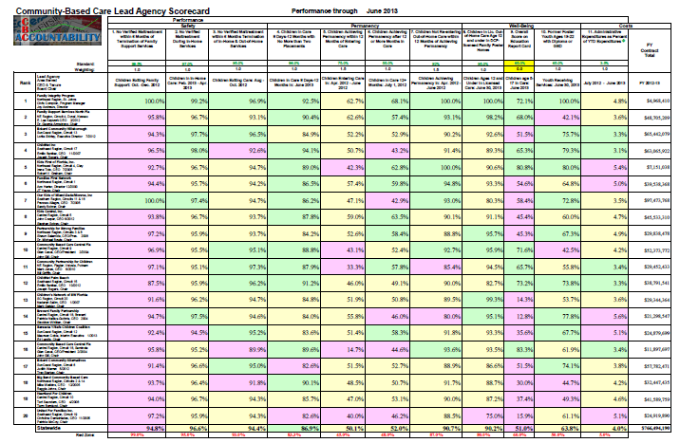

Community-Based Care Lead Agency Scorecard
Eleven Performance Measures
Three Safety Measures
Four Permanency Measures
Three Well-Being Measures
One Cost Measure
Twenty Child Welfare Community-Based Care Lead Agencies

Slide 11

Spinners
Some quick Workforce examples.
See handout for links to more:
Workforce
Public Assistance Caseloads and Characteristics
Child Welfare Performance and Characteristics

Slide 12

From Snapshots to Movies

Slide 13
TANF Adults in Sept. 1996
Oct. 1996 to June 2011
ALL

Slide 14
TANF Children in Sept. 1996
Who Are Now Adults
All

Slide 15
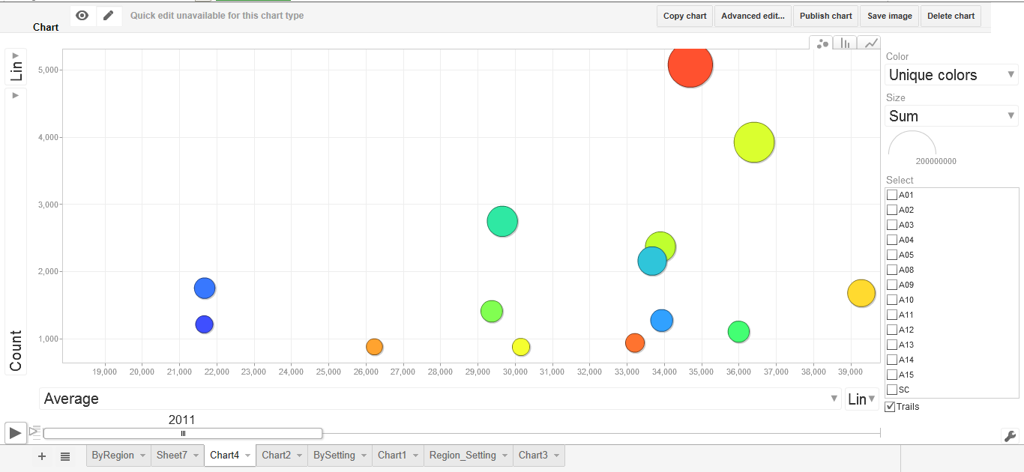
Example
Google Motion Chart

Slide 16
Links and Resources
Links to all of the reports referenced in the workshop (and more) are on the session handout. For an electronic copy, visit WinsteadConsulting.com and click on the documents tab.
The document may also be available at the NAWRS 2013 web site.
Join us for more conversation at the Special Topic Lunch in the Huron Room at Noon today.

